Slide 1
Neural Network Hyperparameter Testing Using Hamming
LTC Olha Danilova
MAJ Janet Karanja
LT Charlotte Meyer
LT Kurt Pasque
Updated: 11/16/2023

Slide 2
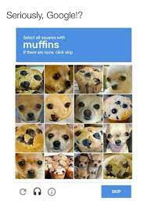
Agenda
Introduction
Data
Neural Networks
GitHub
Local vs. Hamming CPU
Output Analysis
Challenges
Conclusions
Future Work

Slide 3
Research Question
Neural network models are frequently used in classification problems, but their performance on metrics like accuracy and robustness are highly dependent on the hyperparameters that users set when constructing the model.
Given this, how can we run multiple tests of different parameters in parallel using the high-performance computing (HPC) cluster here at NPS to find optimal hyperparameter settings of a neural network.

Slide 4
Motivation
"Right now there are hundreds of engineers in the bay area being paid lots of money to make tiny tweaks to lambda values [a hyperparameter of regularized neural networks] on their models" -Professor Johannes Royset
Experimenting with hyperparameters to aid in simulation models, optimization models, and data analysis algorithms and more
Extending from NPS: mass testing of hyperparameters to ground our hyperparameter decisions for future models and projects

Slide 5
The Experiment
Using 2 open-source image datasets and using 1 neural network model structure, we will test model accuracy by adjusting 1 hyperparameter that affects the model structure and perform some simple analysis on its performance.

Slide 6
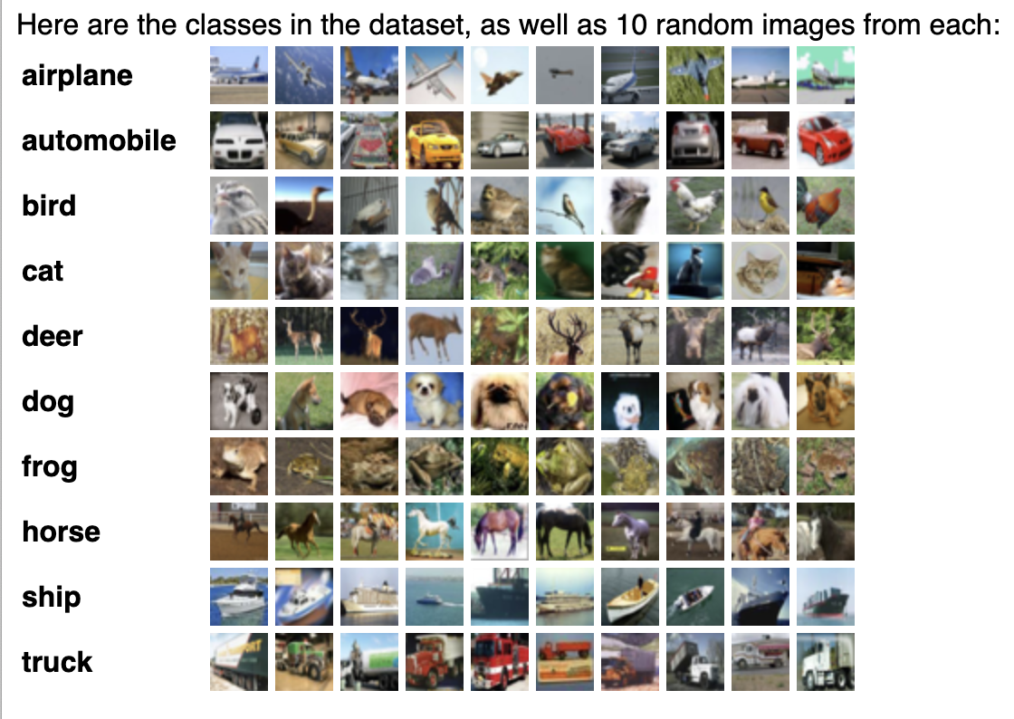
Data - CIFAR
60000 32x32 colour images in 10 classes, with 6000 images per class.
The 10 classes are mutually exclusive.
50000 training images and 10000 test images.
Divided into five training batches and one test batch, each with 10000 images.
http://www.cs.toronto.edu/~kriz/cifar.html

Slide 7
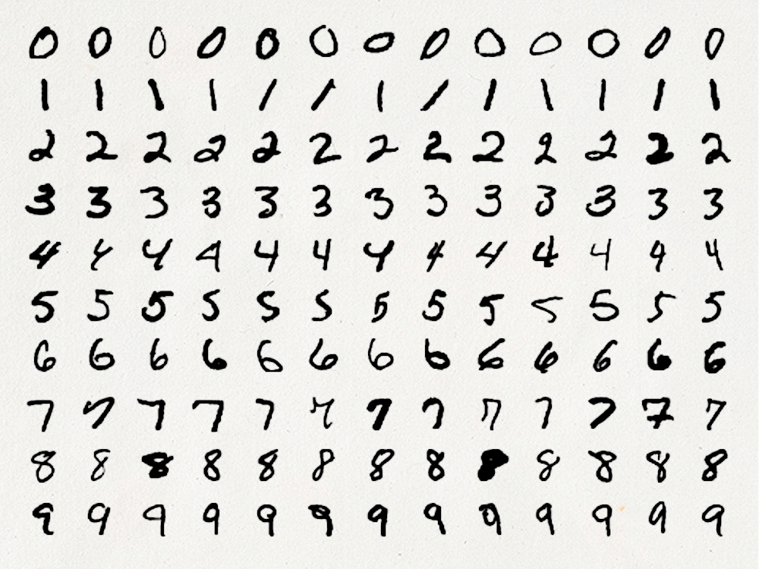
Data - MNIST
Database of handwritten digits
Training set of 60,000 examples, and a test set of 10,000 examples.
https://www.kaggle.com/datasets/hojjatk/mnist-dataset

Slide 8
Data – Pros/Cons
Pros
Challenges
Each dataset is publicly available and we obtained them via simply downloading from the source website to our local machine.
Stored in very compact file types
Each stored in different and obscure file types at the point of download. Custom methods for each dataset had to be constructed that could load the data into memory and adjust them to be in the appropriate input data structure we needed. All these methods needed are contained within our functions/load_data.py file (more on our experiment file structure later).

Slide 9
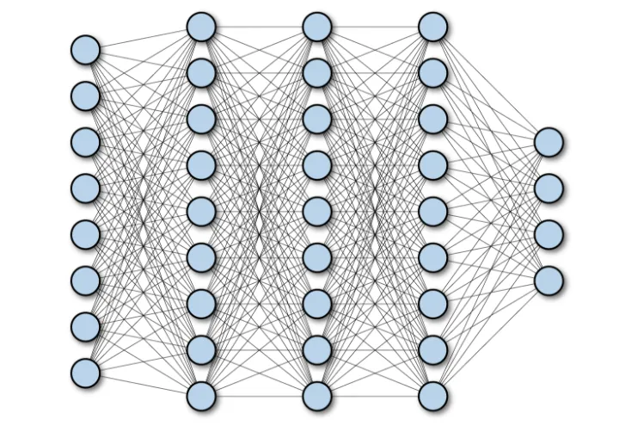

Neural Networks Overview
High-level overview: Neural networks are mathematical models composed of interconnected nodes (neurons) that process and transform input data through layers to learn patterns and relationships, iteratively adjusting weights and biases, usually with the goal to optimize a predictive task.
How neural networks “learn”: Weights and biases are initially set randomly, then adjusted using the gradients of an error function, enabling the network to “learn” by minimizing the error function.
Activation Functions: A key element of neural networks is the activation function. Activation functions in neural networks introduce non-linearities to the output of each neuron, allowing the network to model and learn complex, non-linear relationships within data. Without activation functions, neural networks would reduce to a series of linear transformations, limiting their capacity to learn and represent intricate patterns in data. The most common activation function that we will use called a rectified linear unit (ReLU). The function is simply the max between 0 and a given number.

Slide 10


Convolutional Neural Networks (CNN)
Abstract idea behind CNN's: Different, small sets of paramters (referred to either as filters or kernels) are optimized and "learn" different patterns and spatial features of input data. For images, this could mean a filter "learns" where vertical edges are and another might "learn" a certain texture pattern and so on. These learned filters are then able to provide "maps" of where their feature occurs within an image, which is highly useful to classifying many types of data like images.
The convolution operations: The convolution operation itself effectively "slides" or "convolves" the fitlers across the input data, extracting features through localized information aggregation and placing the results into a "map". Below is a nice 2-D visualization of how the convolution operation works and generates a feature map. Please not that the filter does not change while it slides (image source: https://saturncloud.io/blog/a-comprehensive-guide-to-convolutional-neural-networks-the-eli5-way/):
Broad idea behind CNN's: Different, small sets of parameters (referred to either as filters or kernels) are optimized and "learn" different patterns and spatial features of input data. For images, this could mean a filter "learns" where vertical edges are and another might "learn" a certain texture pattern and so on. These learned filters are then able to provide "maps" of where their feature occurs within an image, which is highly useful to classifying many types of data like images.
2 important layers commonly used in CNN’s:
Convolution layer: The operation effectively "slides" or "convolves" the filters across the input data, extracting features through localized information aggregation and placing the results into a "map".
Pooling layer: Another key aspect of many CNN's is pooling layers. There are no parameters in these layers as they simply try to reduce the feature maps into only the most important features.

Slide 11
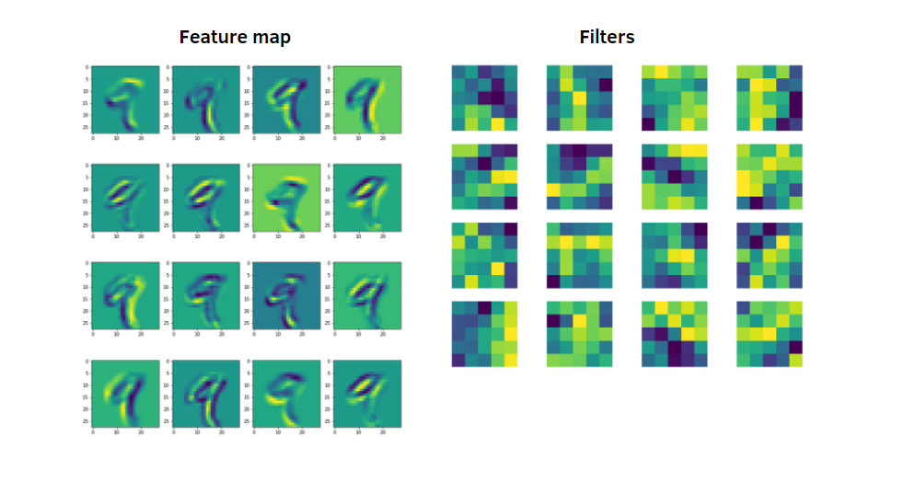
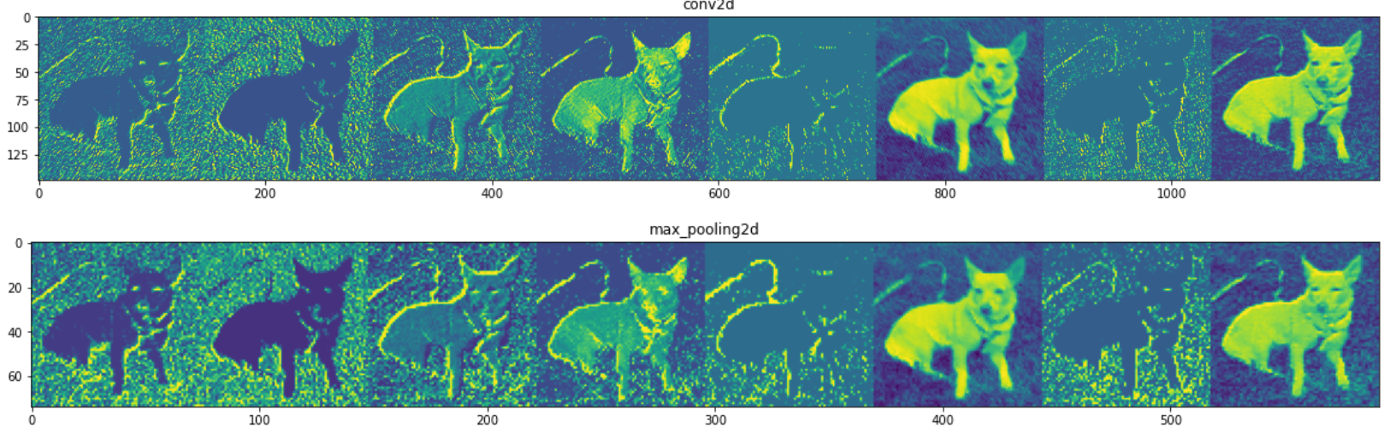
Feature Maps Visualized
To gain more intuition as to what CNN’s are doing with their convolutions, here are some visualization of the feature maps generated by trained filters.

Slide 12

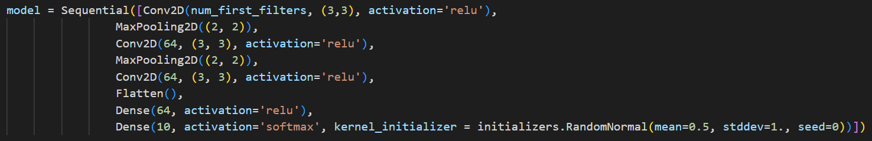
Our Neural Network
Our CNN utilizes 3 convolutional layers and 2 max pooling layers, followed by 2 fully connected layers that predict the “class” of the image input into the model.
Below is how you implement this in Python using the Tensorflow package (imports excluded). As you can see our model parameter we will be testing is the number of filters in the first convolution layer.

Slide 13
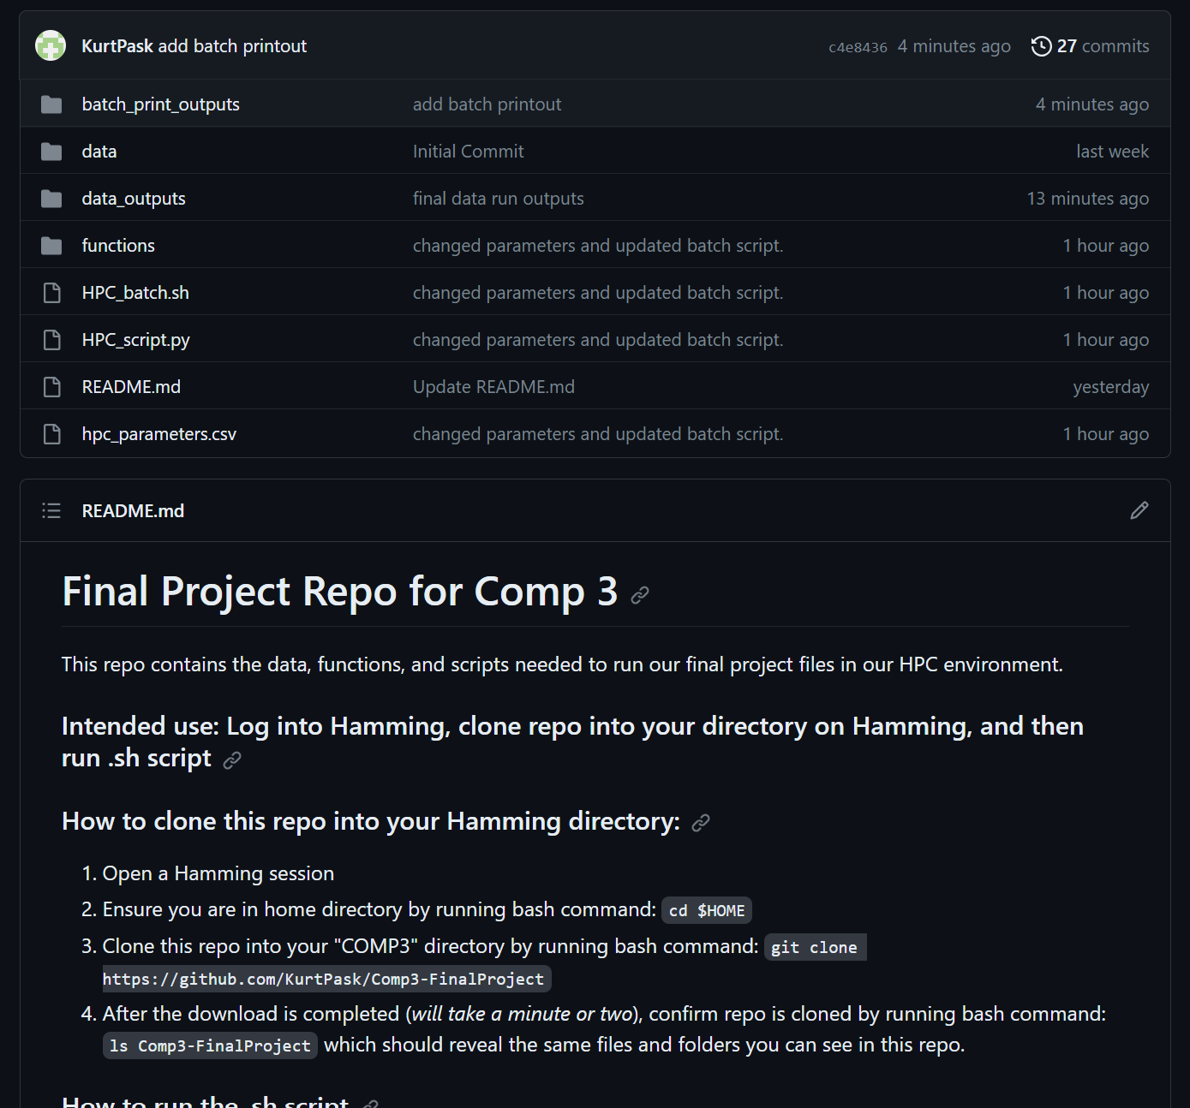
GitHub
GitHub - KurtPask/Comp3-FinalProject
We have created a GitHub repository (repo) that contains the data, functions, and scripts needed to run our final project files in our HPC environment. The goal of the repo is that it can be used by anyone, given they follow the instructions for how to use the project in Hamming on the displayed README.md.

Slide 14
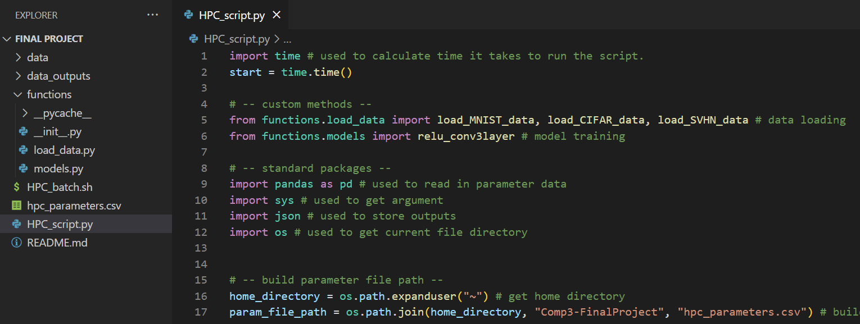
Repo Structure
We stored some of our more complex functions within sub-folders. This enables us to read in each function we need as an import, simplifying the readability of our code and enabling to scale up into more experiments down the road.

Slide 15
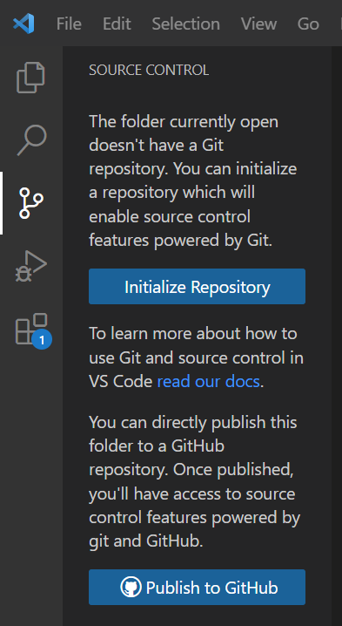
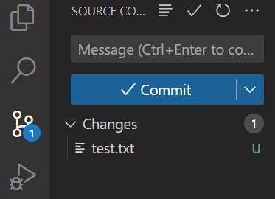
How we Created our Repo
The Visual Studio Code Interactive Developer Environment (IDE) has a feature we used that can help you (1) wrap a folder as a git repository and (2) publish it to your GitHub account. If follow-on work is done in Visual Studio, there are buttons that can simplify adding, committing, and pushing changes to GitHub.

Slide 16
Local vs. Hamming CPU
Local
We did not do a full test of all 100 hyperparameter tests on a local machine, but we ran the first 2 and the last 2 parameter settings in our hpc_parameters.csv file. After making some broad assumptions on how long the runs would take in between, our estimated local run time would be ~21 hours, ouch!
Hamming CPU
Implementing our script by running each hyperparameter test in parallel on Hamming resulted in a runtime of ~84 minutes, 15 times faster than our local implementation!

Slide 17
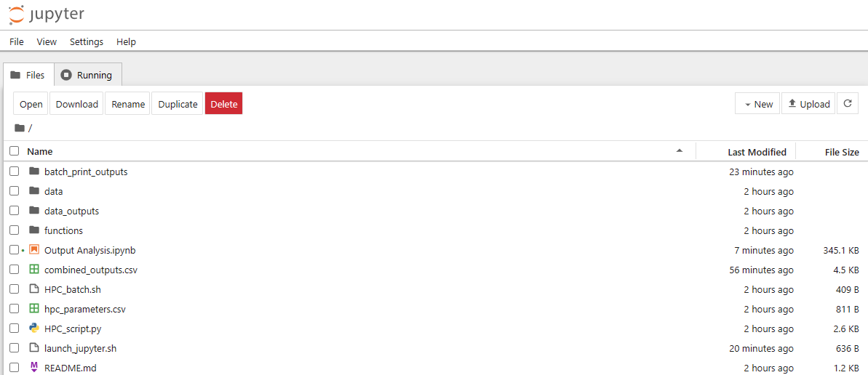
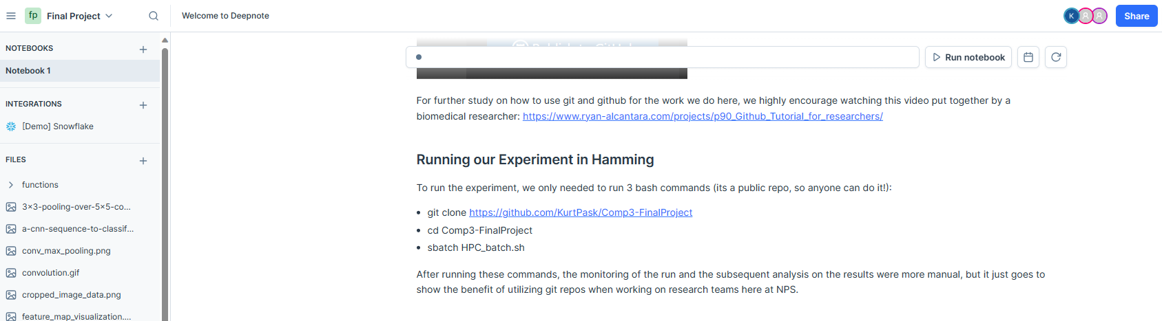
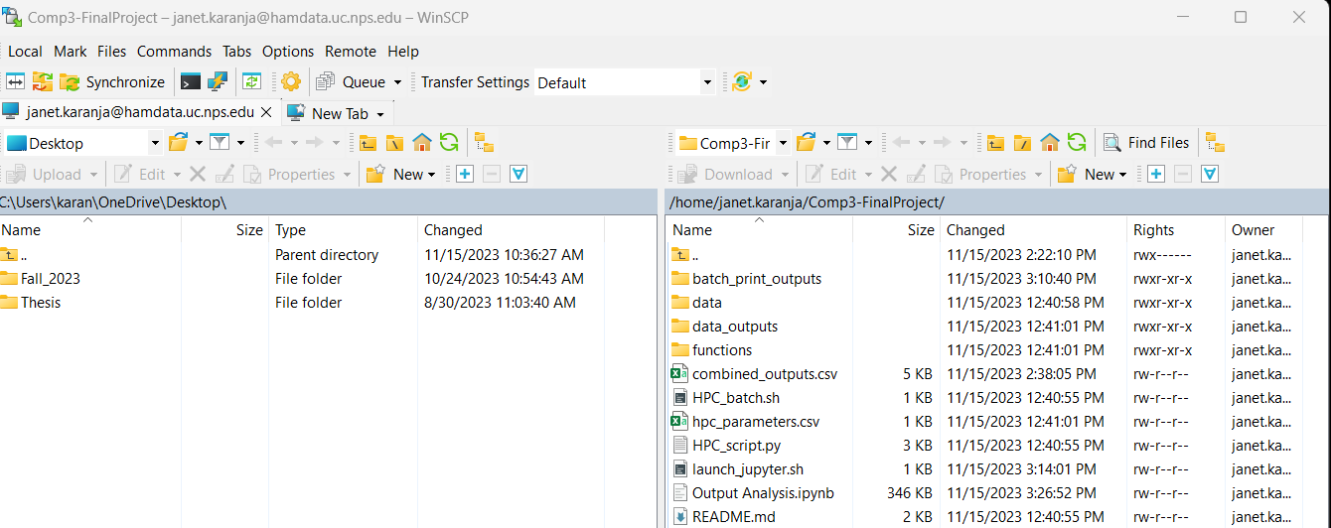
Jupyter Notebook
Deepnote:
Simultaneous editing
WinSCP to facilitate output analysis
Hamming:
Each user
Seamless output analysis

Slide 18
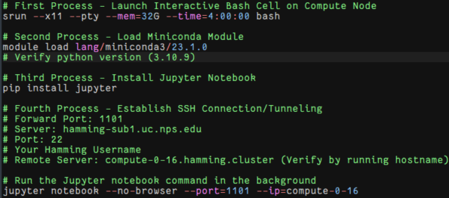
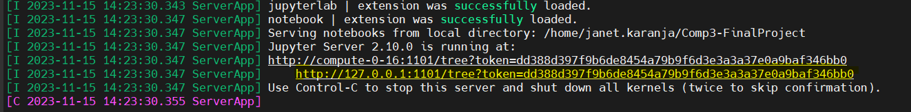
Launch in Hamming
Step-by-step process of launching Jupyter notebook on Hamming

Slide 19
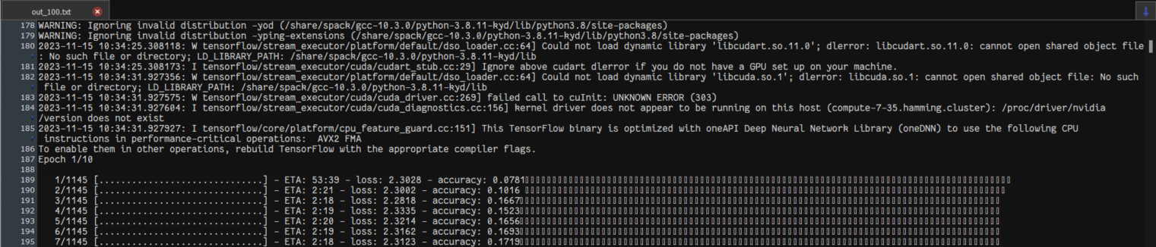
Output Files
Data Outputs: JSON files
Print Outputs: Text files

Slide 20
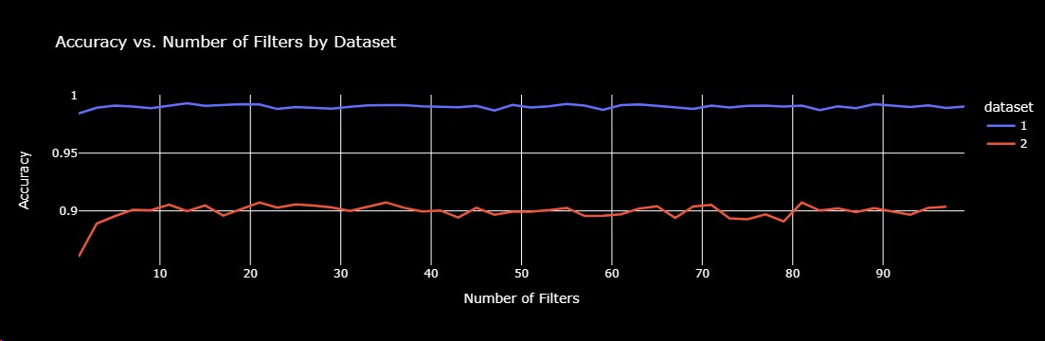
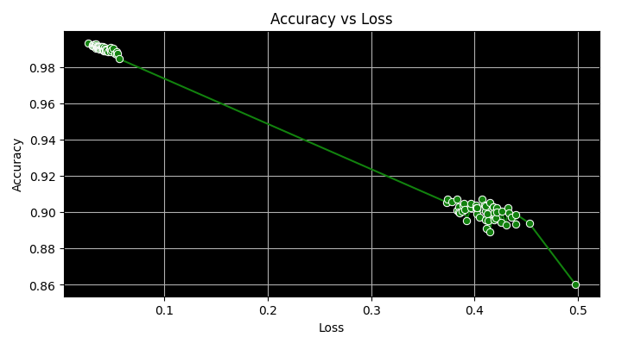
Output Analysis
Total results : 100
Average loss: 22.3%
Average accuracy: 94.53%

Slide 21

Challenges, conclusions
Challenges
Using Hamming for this experiment was not trivial!
Debugging can be challenging in Hamming.
Conclusions
The basic methodology used where we feed index values to a python script that then reads in the hyperparameters to test, can be applied to many use cases relevant to the students thesis work in our class or various OR tasks.

Slide 22
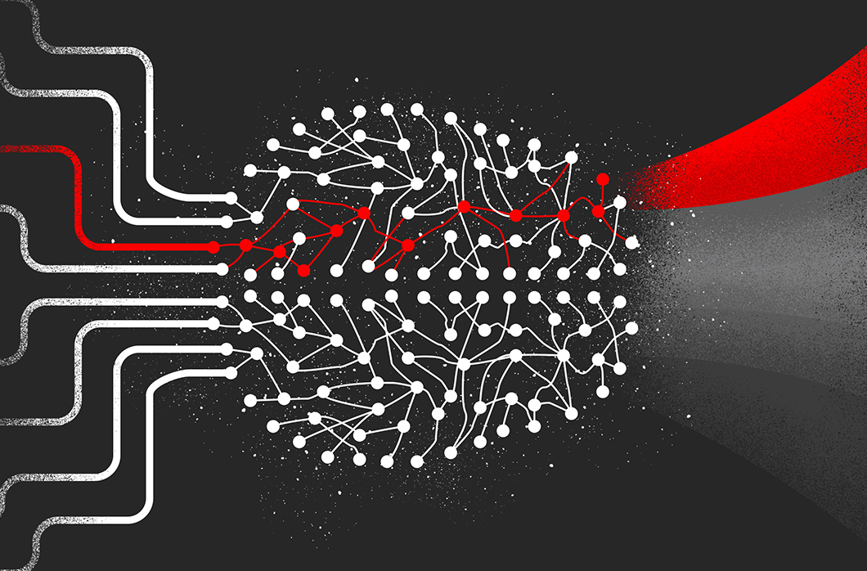

Future work
Interesting extensions of this work:
Make this methodology more robust
Evaluating other metrics
Utilizing GPU's
Improving the user experience

Slide 23

Questions

